Slide 1

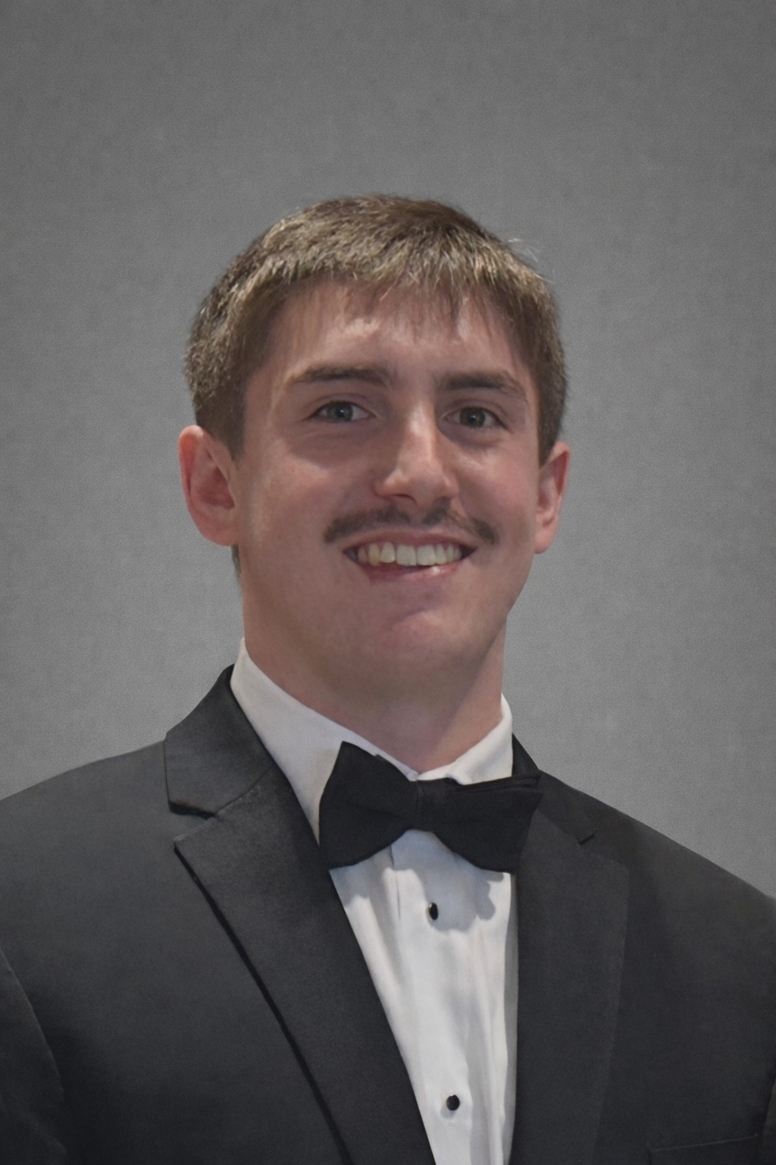



Sprint 2 Presentation
Insighters Inc. Workflow Automation
Tyler Bish, Keegan Doyle, Ayush Singh, EJ Jones
Website URL: https://kmdoyle2.github.io/
Private Cloud URL: https://insighters-workflow-automation-428824878696.us-central1.run.app/
GitHub Repo URL: https://github.com/tjbish/InsightersIncWorkflowAutomation
Tyler Bish
Keegan Doyle
Ayush Singh
EJ Jones

Slide 2
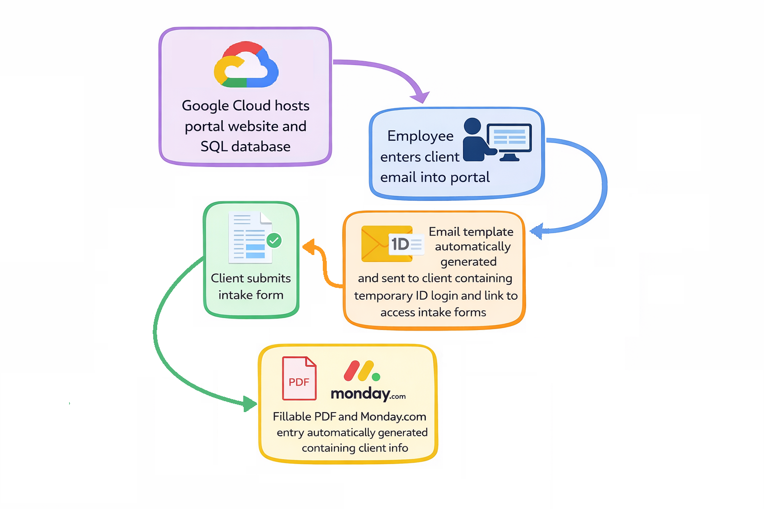
Project Workflow and Focus

Slide 3



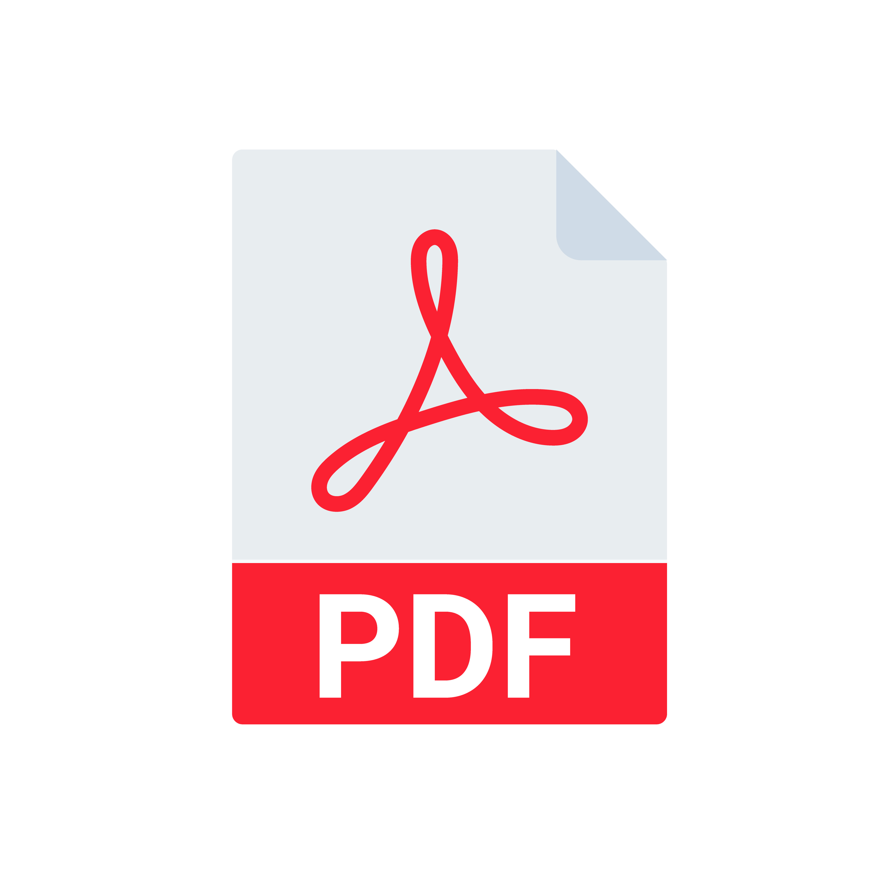

Prioritized Sprint Goals
Google Cloud Deployment
PDF Generation
OAuth Integration
Monday.com API Integration
Email Communication
Notes:
*Adding the Django app to the Cloud via Google Cloud Run
*Generating a PDF intake form
*Implementing OAuth for admin users
*Update client info via Monday.com API
*Sending communication to the client as well as a confirmation to the admin users

Slide 4



Sprint Achievements & Sponsor Feedback
Client Email Automation
Fillable PDF Generation with Client Data
OAuth Integration for Employees
Integrating Monday.com
Deployment to Google Cloud
Overwhelmingly positive feedback from sponsors via biweekly meetings
Notes:
Our major achievements during this sprint include automated generation and sending of emails to clients containing temporary IDs and hyperlinks to access submission forms, automated generation of a fillable PDF document containing new client information constructed using an existing company template, connecting the project pipeline to the company's existing Monday.com CRM for easy access to crucial client contact information, and finally deploying everything via Google Cloud Run and integrating our data storage into the Google Cloud SQL server. So far our sponsors have provided nothing but positive feedback offering us creative liberty to design improvements as we see fit.

Slide 5
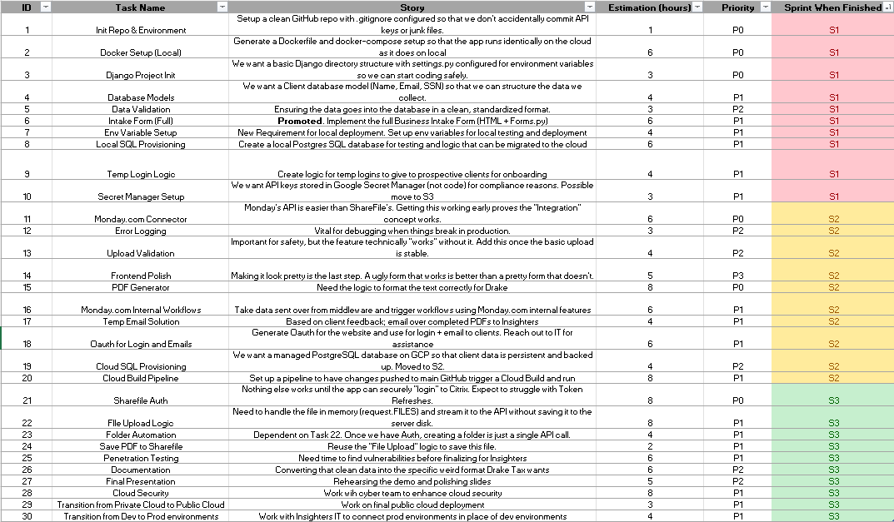
Project Backlog

Slide 6
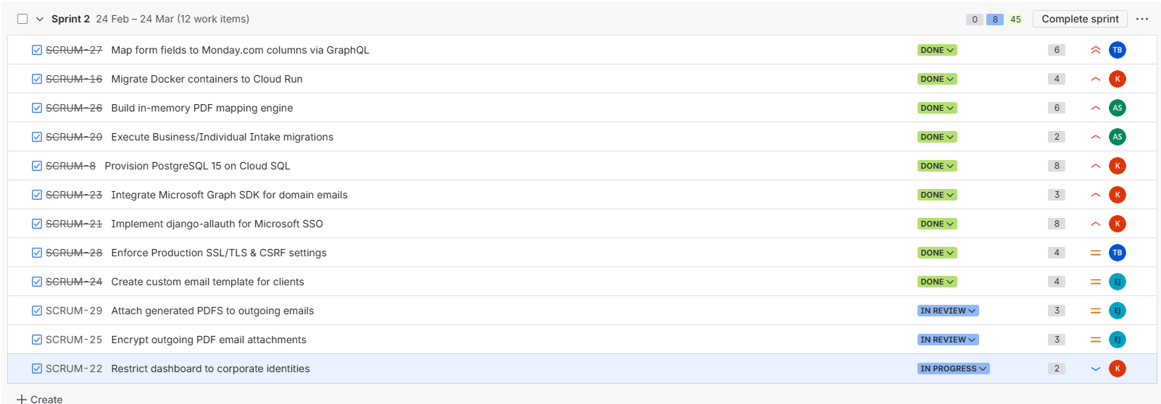
Sprint Backlog
Significant Backlog Items
Cloud SQL Provisioning and Cloud Run setup
Implement django-allauth for Microsoft SSO
Build in-memory PDF Mapping Engine
Map Form fields to Monday.com columns via GraphQL

Slide 7
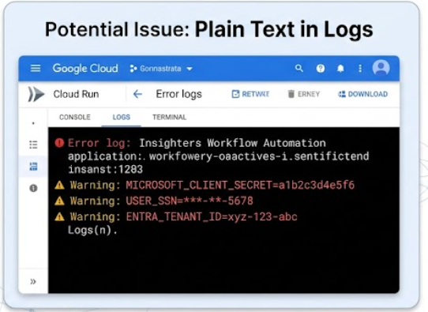
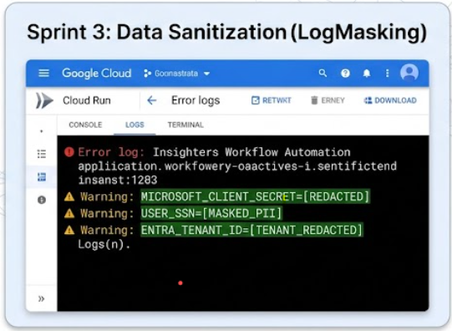
Cyber Assessment
Positive Feedback
No major vulnerabilities found by vulnerability scanner
Potential Issues (Risks Identified)
Possibility of secrets and PII in cloud logs
Verified Local Environment Isolation
For the Next Sprint (Mitigation)
Log Sanitization in Google Cloud
Sensitive Data Masking
Notes:
Moving onto our cyber assessment for this sprint, we again had positive feedback from our Cyber team who did not find any major vulnerabilities with the application. They did present some potential risks for the public cloud deployment. There is potential for PII and secrets to be exposed in the cloud logs, though this was not seen in the local environment. For the next sprint we will need to sanitize our cloud logs and mask sensitive Data

Slide 8

What Was Not Completed
Cloud Security
After initial deployment, we did not get the opportunity to ensure that application is properly secured and protected in Google Cloud
Task pushed to final sprint

Slide 9
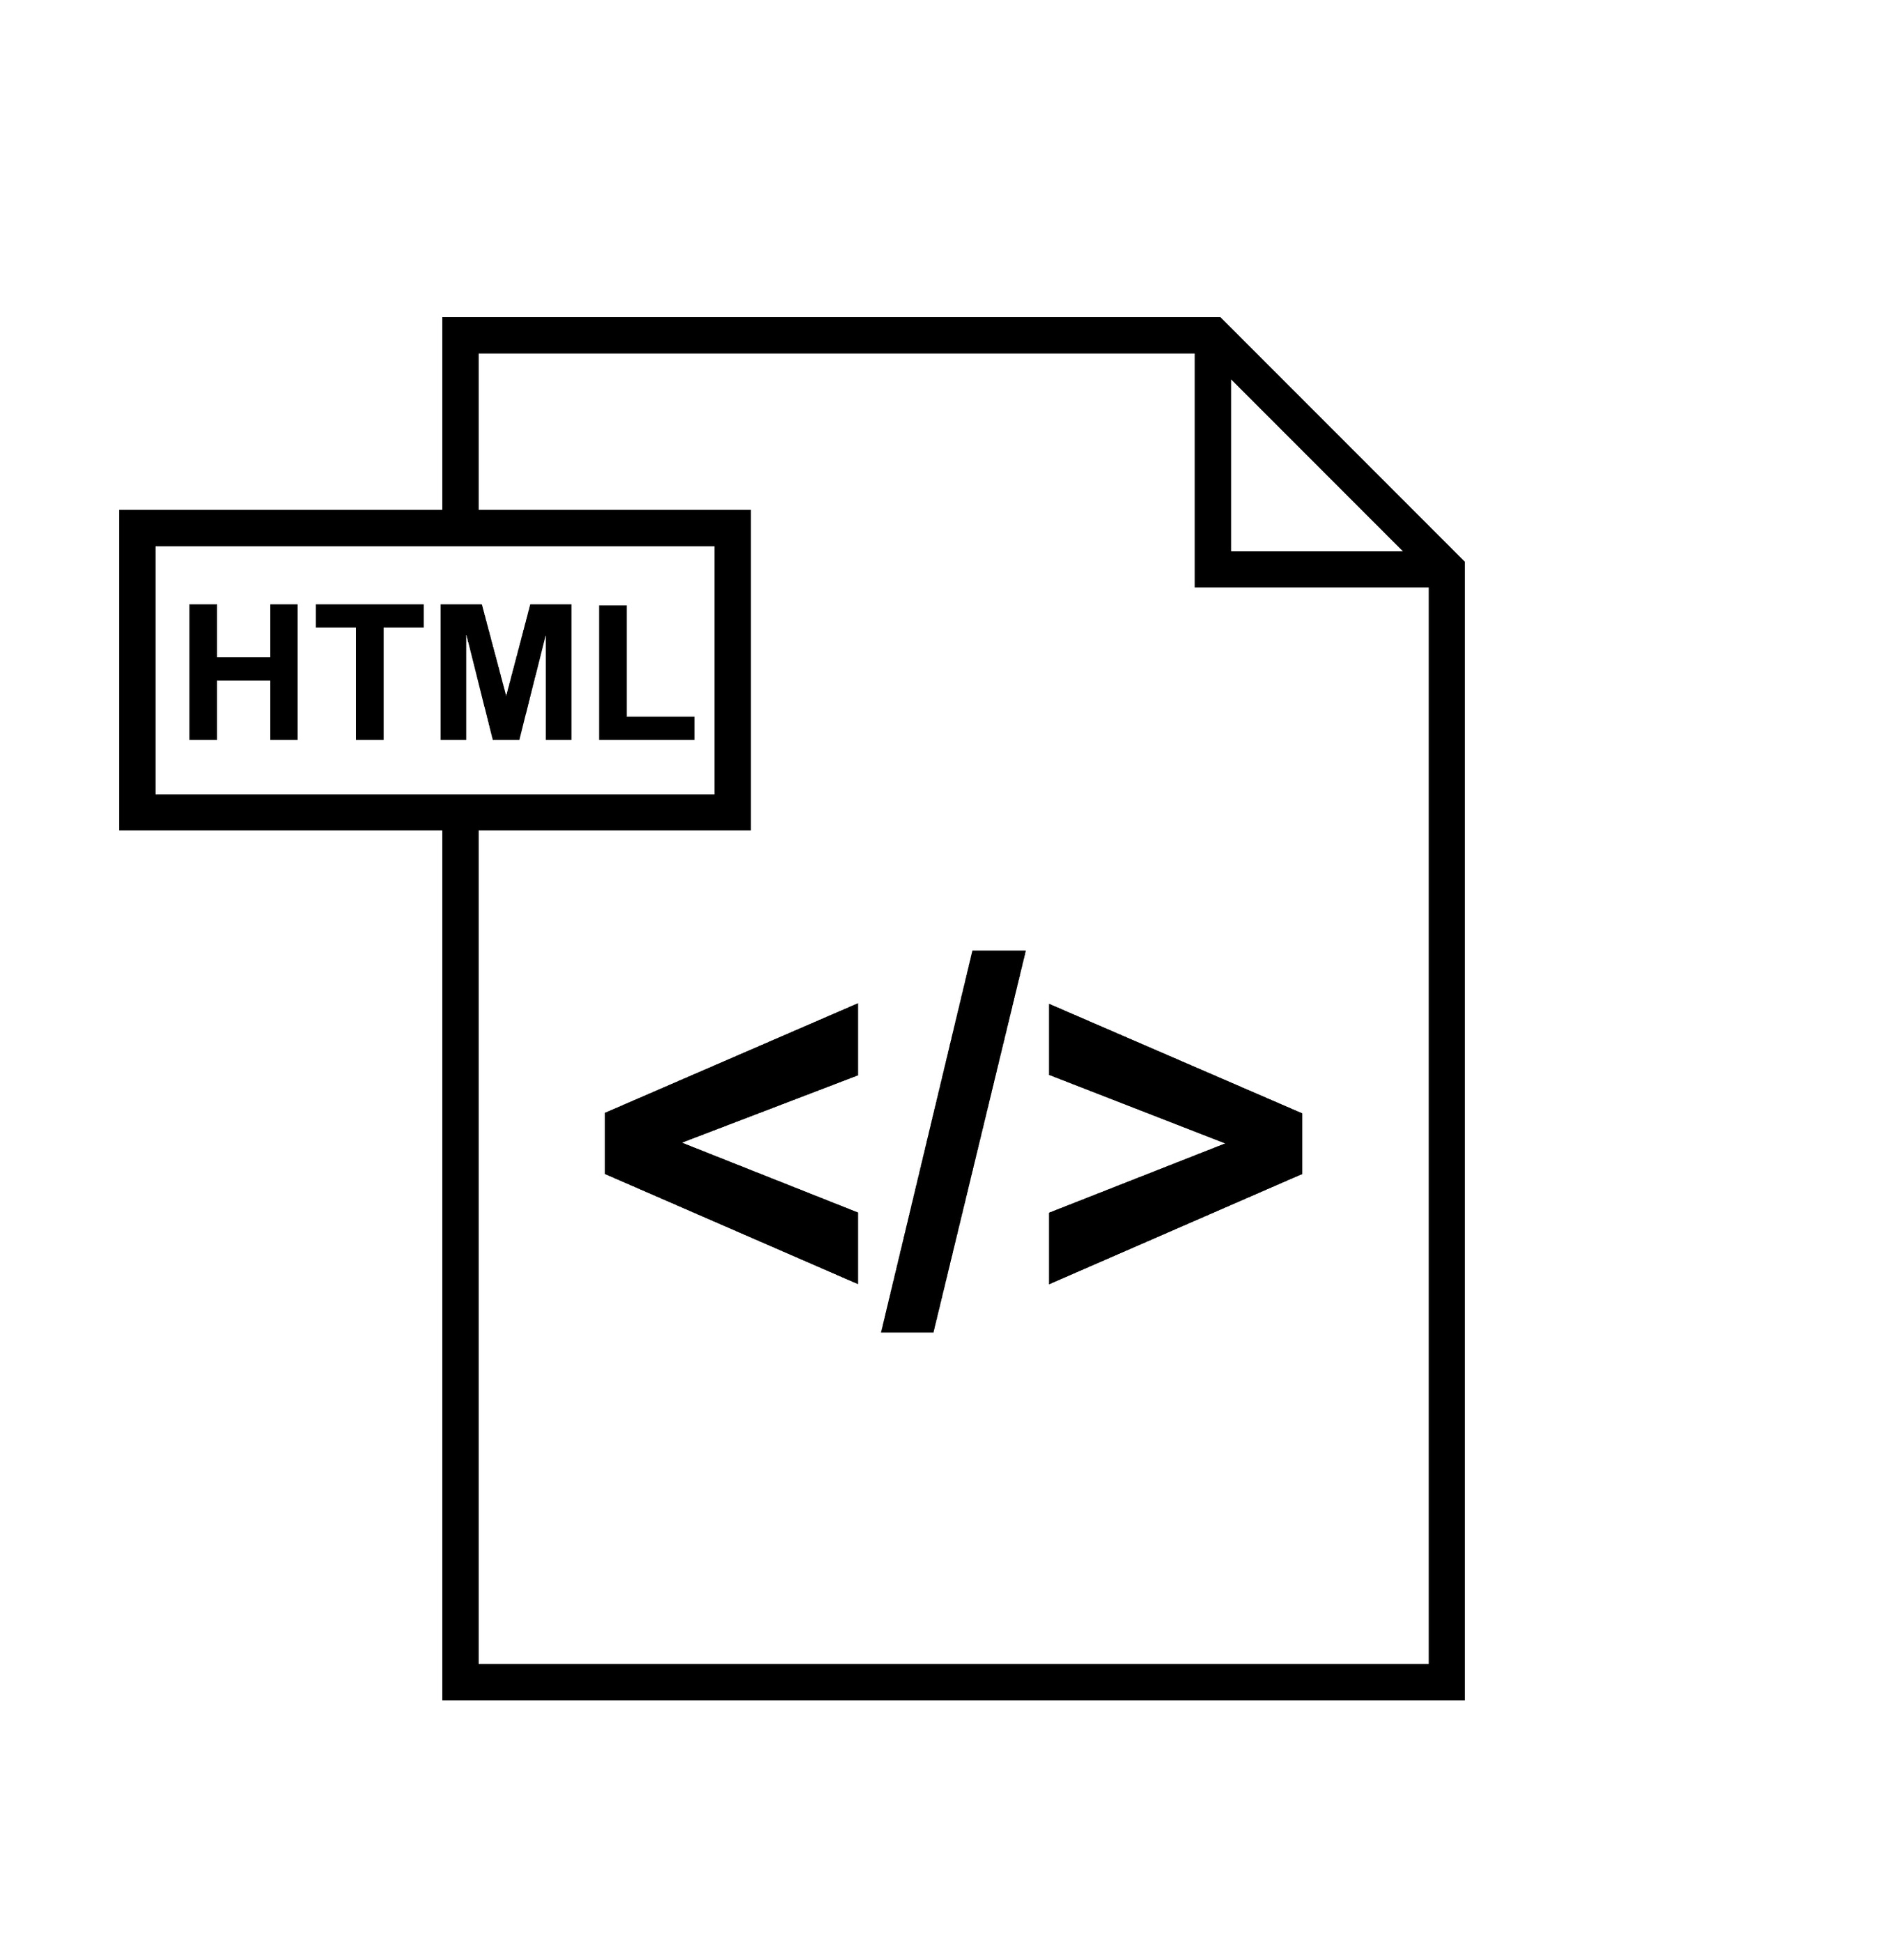

Contributions – EJ Jones
Created Email Templates
Two templates created for confirmation emails and intake instructions
Confirmation Email Logic
Created the logic used is email.py for both types of email templates
PDF Attachment
Wrote logic for attaching Intake forms to confirmation emails

Slide 10





Contributions – Keegan Doyle
Microsoft OAuth SSO
Integrated OAuth via Entra ID for application SSO
Automated Client Emails
Used Microsoft Graph API to distribute secure intake emails to clients
Private Cloud Infrastructure
Automated CI/CD of cloud deployment using Cloud Build, Cloud Run, and cloudbuild.yaml
Cloud SQL Provisioning
Provisioned Postgres 15 Cloud SQL database for the live application
Notes:
For my sprint 2 contributions I integrated Microsoft Oauth SSO into the live site via Entra ID for the admin dashboard, automated email sending to prospective clients using the microsoft graph API and Entra ID
I set up a private Cloud instance using cloudbuild.yaml to initialize a build pipeline from cloud build to cloud run
I finally provisioned a Cloud SQL DB using Ayush’s local database migrations for the live application.

Slide 11


Contributions – Tyler Bish
Monday.com Integration
Established modular GraphQL API calls to automatically add client info to CRM
GitHub Security & Integration
Facilitated branch security and merging to maintain functionality during transition to cloud deployment
Debugging & Unit Testing
Confirmed integrated functionality of all sprint features and fixed errors when present
Notes:
My contributions during this sprint include fully integrating the sponsor's Monday.com CRM for managing client info, automatically generating entries for crucial client contact info, as well as managing our Github branch security, resolving merge conflicts, and providing overall assistance in debugging and unit testing when new features were implemented.

Slide 12


Contributions – Ayush Singh
PDF Generation Engine
Built backend logic to generate completed intake PDFs from submitted form data
Field Mapping System
Designed mapping between Django form inputs and PDF fields, including structured and checkbox data
Cross-Platform Rendering Fix
Implemented fixes to ensure PDFs display correctly across viewers, including Windows Acrobat

Slide 13
Technologies Used
Technology | Good | Bad
Google Cloud | Reliable and Automated | Complex and Challenging
Entra ID/OAuth | Secure and Professional SSO | Difficult to set up a test environment
Microsoft Graph API | Can send emails from Insighters Domain | Rate limiting on Dev tenant
Django (Allauth/Base) | Abstracted OAuth integration | Initial Learning Curve
PyPDF | Easily maps to fillable PDF | Compatibility Issues
Monday.com (GraphQL) | Great documentation | PII handling issues

Slide 14

Demo

