Slide 1

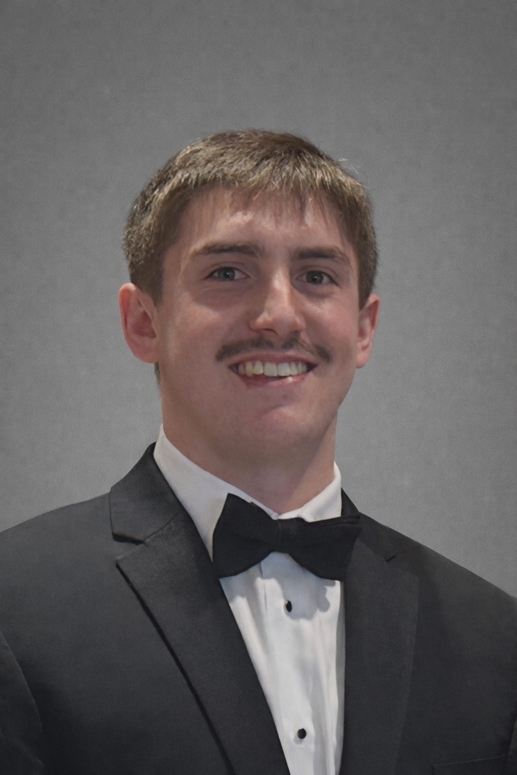

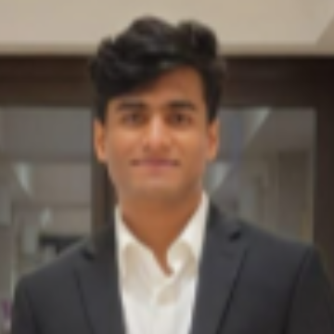

Sprint 1 Presentation –
Insighters Inc. Workflow Automation
Tyler Bish, Keegan Doyle, Ayush Singh, EJ Jones
Website URL: https://kmdoyle2.github.io/
GitHub Repo URL: https://github.com/tjbish/InsightersIncWorkflowAutomation
Tyler Bish
Keegan Doyle
Ayush Singh
EJ Jones

Slide 2
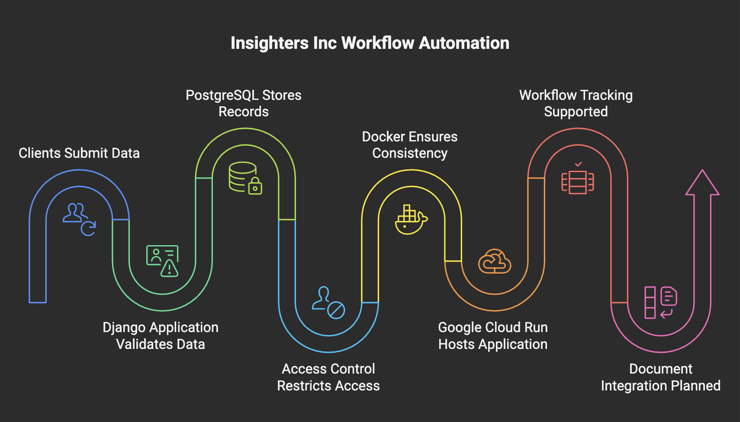
Project Workflow and Focus

Slide 3

Prioritized Sprint Goals
Understanding of Client’s Goals
Ensure a complete understand of client’s current problem and goals and presenting a solution
Docker Setup (Local)
Generate a Dockerfile and docker-compose setup so that the app runs containerized
Django Project Initiation
Creating a Django application and web form based on the sponsor provided onboarding templates
Consistent Security Implementation
Adding security features during app creation to ensure a secure environment
Database Setup
Create a local Postgres SQL database for testing and logic that can be migrated to the cloud

Slide 4


Sprint Achievements & Sponsor Feedback
Docker, Django, and GitHub Implementation
Django web application fully functional and containerized.
All relevant code is available in a GitHub repository with branch control and main protections.
Admin Dashboard & Home Page
Intuitive directory and easy access for employees
Database Integration
PostgreSQL database fully implemented to track workflow progress and provide data persistence
Secure and Efficient
Passwords and PII are obfuscated or omitted from the database
Strict permissions required for access
Sponsor & IT In-The-Loop
Biweekly sponsor meetings to share progress, address questions, and receive updated instructions with current positive feedback
Notes:
Our major achievements during this sprint include successful implementation of a Docker containerized Django web-app with all source code available in GitHub. This web app includes an intuitive directory and admin dashboard for managing intake forms and ID generation, it is fully integrated with our PostgreSQL database for data persistence and is fully secure with passwords and PII being obfuscated or omitted entirely from the database. We have received overwhelming positive feedback from our project sponsor, who has been kept in the loop at every step of the way via biweekly meetings.

Slide 5
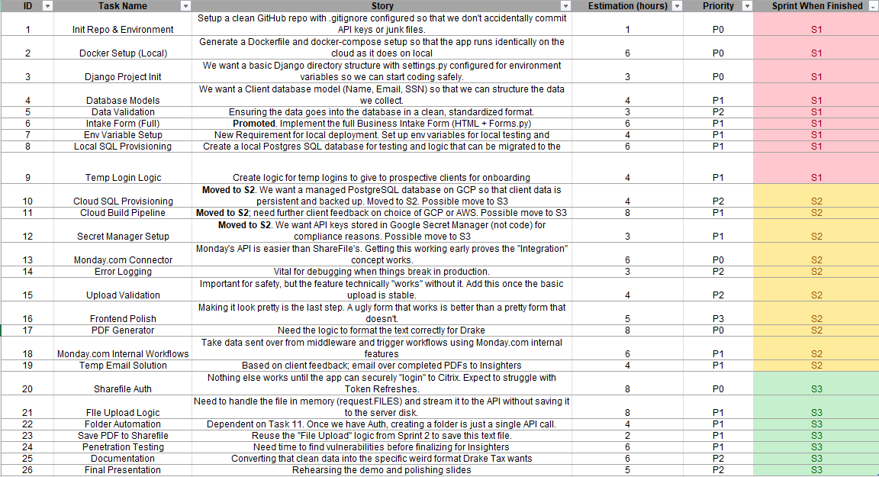
Project Backlog

Slide 6
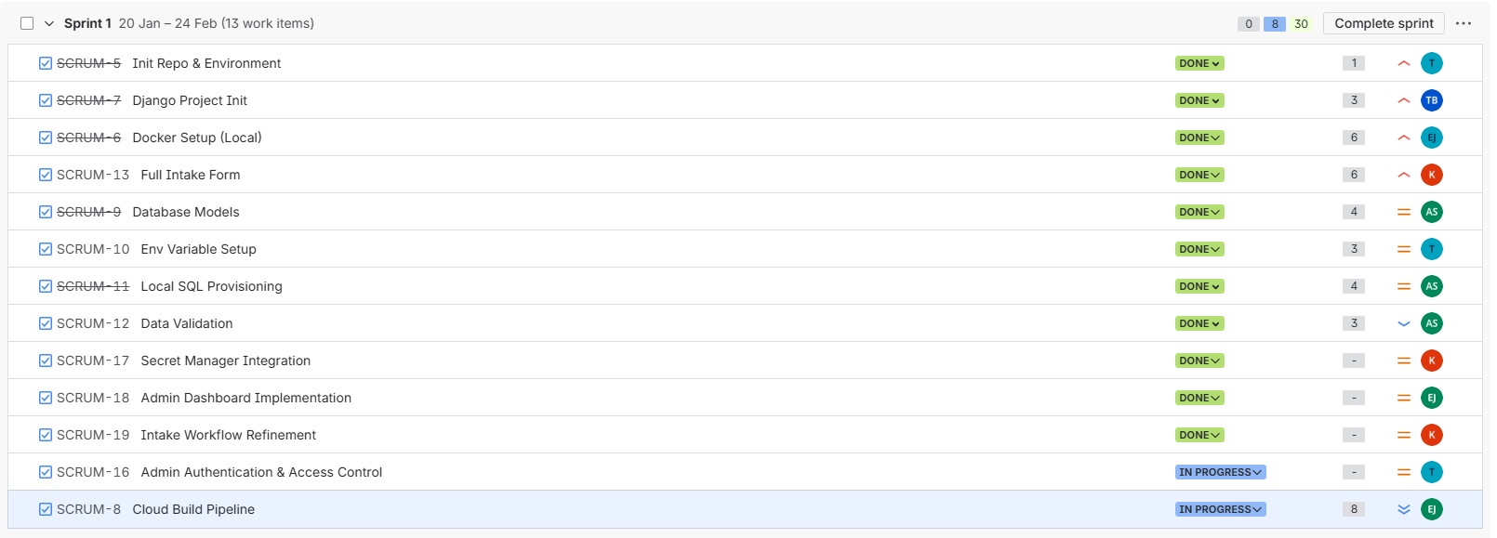
Sprint Backlog

Slide 7
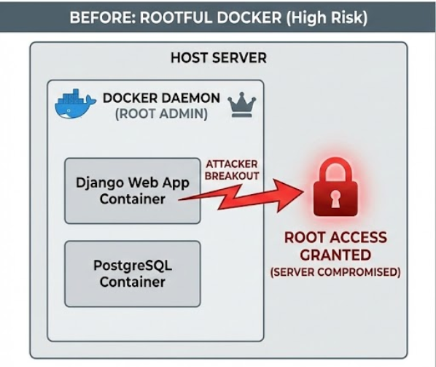
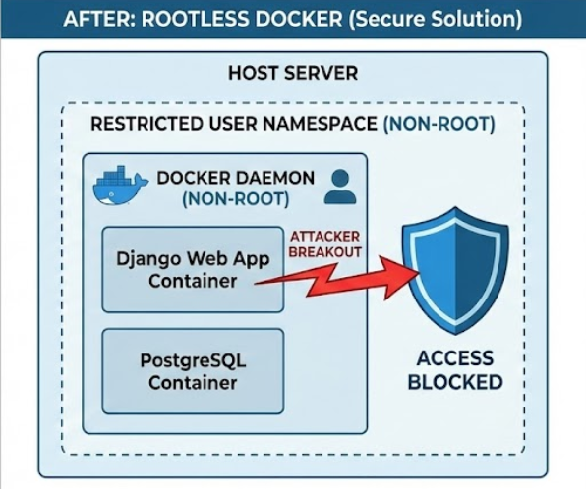
Cyber Assessment
Initial Feedback
No major vulnerabilities found. The initial scan found a solid baseline with only one minor, but necessary, action item.
Main Action Item
Reconfigure the deployment environment to run Docker containers without root privileges.
Why is rootless Docker needed?
It prevents Privilege Escalation. Rootless Docker runs containers without admin privileges. If a container is ever breached, the host server remains protected.
Solution
Update the project's Dockerfile to create a dedicated, unprivileged user instead of relying on the default superuser.
Notes:
This is our Cyber Assessment - The initial feedback from our cyber consultants was very positive other than one main action item
Our initial docker deployment ran in root mode which needed to be switched to running as rootless containers
If a Docker container is running with a root user and an attacker gains access to the container, they can use privilege escalation to access the host server
By updating our Dockerfile to have a dedicated unprivileged user, we patched this vulnerability.

Slide 8


What Was Not Completed
Cloud Deployment
After being met with changes in the project scope we were forced to push all cloud implementations into Sprint 2
Also, we needed more feedback on what Cloud-Service Provider (CSP) the client wanted to use

Slide 9

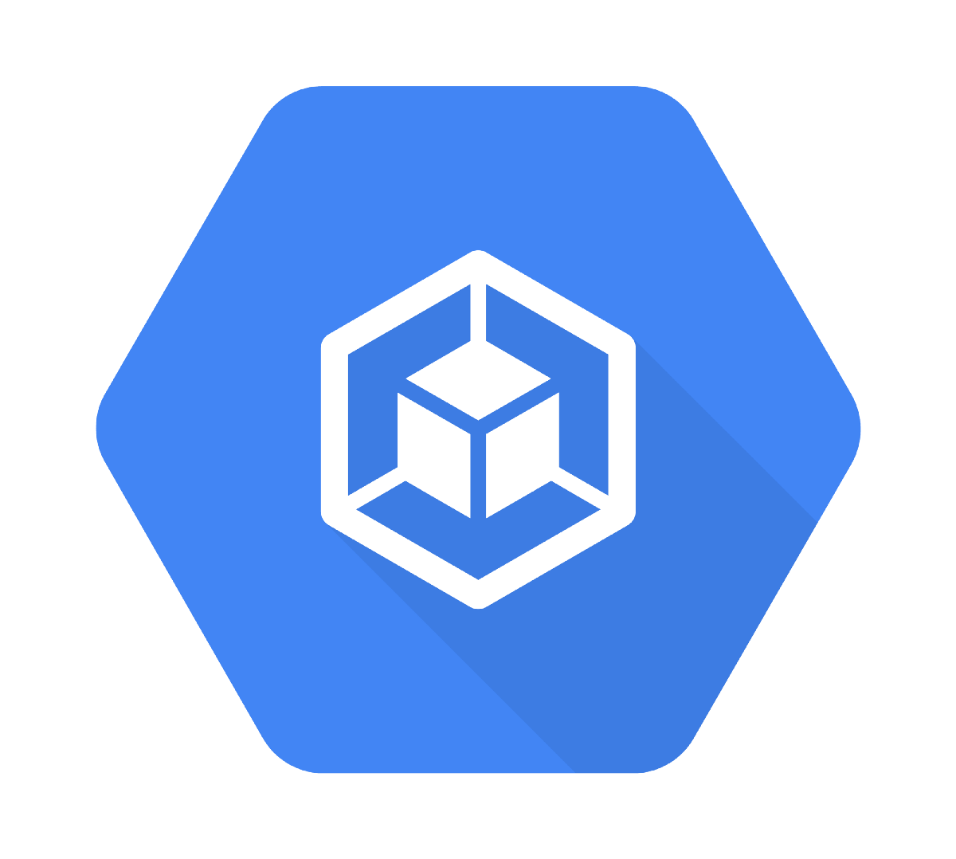
Contributions – EJ Jones
Created Admin Login Page
Used for admin authentication for access to the admin dashboard
Provides security between the Insighter’s Inc client view and the admin dashboard
Implemented Rootless Dockerfile
Created an appuser and group to avoid running the app as a root user (Security)
Configured cloudbuild.yaml and production.py files
Used for CI/CD using Google Cloud Run (Implemented during Sprint 2)

Slide 10



Contributions – Keegan Doyle
Docker and GCP Initial Setup
Configured local Docker environment and initiated Google Cloud Platform (GCP) setup via custom initialization scripts.
Google Secrets Manager
Integrated Google Secret Manager to secure API keys and database credentials for the production environment.
Intake Forms Backend
Engineered the Business and Individual intake forms in Django, including comprehensive server-side data validation, and unit testing
Intake Forms Frontend
Built the user-facing HTML/Bootstrap templates for the intake forms.
Notes:
Again I am Keegan Doyle
My main contributions were to setup the local Docker environment with the Dockerfile and Docker Compose file
I also setup the init scripts for the google cloud platform
I worked on Google Secrets Manager for our prod environment and successfully tested the implementation
Finally I worked on the intake forms frontend with html5 and bootstrap and backend with django forms. I completed unit testing and server side data validation of the forms.

Slide 11

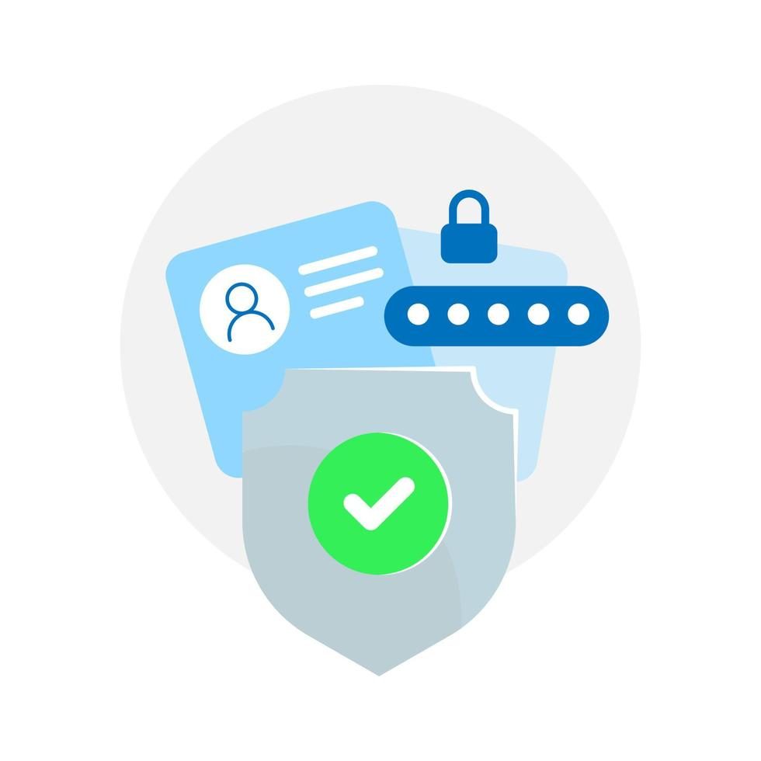
Contributions – Tyler Bish
Django Repository Setup via GitHub
Set up the initial repository structure to easily align with Django web-app development and functionality updates. Established main branch protection to prevent accidental overwrites.
Home Page & Admin Dashboard Frontend
Established initial home page for accessing intake forms and admin dashboard to generate emails and temp login IDs.
Intake Login & Secure Temporary ID Generation
Implemented secure access restrictions for intake forms and admin dashboard.
Generate temporary login IDs for clients accessing intake forms, with verbose generation, expiration, and use timestamps.
Notes:
My contributions during this sprint include establishing the Django web app codebase in GitHub, setting up the home page and admin dashboard, as well as implementing secure access restrictions for intake form and dashboard access. This includes generating and storing temporary IDs in our database with verbose progress timestamps.

Slide 12
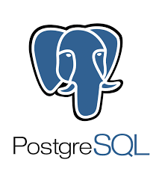

Contributions – Ayush Singh
Database Model Design
Developed Django models to support both Business and Personal intake workflows. Structured the data fields to align with the sponsor’s onboarding requirements.
Schema & Migrations
Generated and applied database migrations to create intake submission tables and ensure models were accurately reflected in the database.
Backend Integration & Security
Updated backend logic to process and store intake form submissions. Ensured sensitive information was not stored and maintained secure data handling practices.

Slide 13



AI Integration
Efficient Debugging & Unit Testing
Testing for race conditions, system-specific error cases, and security vulnerabilities before pushing to shared repository.
Docker Containerization Support
Dockerfile scripting and planning to avoid loss of functionality once GCP integration begins.
Facilitating Documentation
README document initial scripting and adding in-line comments to our codebase.
Quickly parse existing documentation for application support (Monday.com, ShareFile, Drake Portals)
Notes:
We have utilized various AI tools throughout this sprint, including OpenAI's Codex agents, Google Gemini, and GitHub copilot. These tools have primarily been used to expediate our debugging and unit testing, provide support for containerization via Docker, as well as facilitating the parsing and generation of necessary documentation such as application support documents or our codebase's README.

Slide 14

Demo

Slide 15
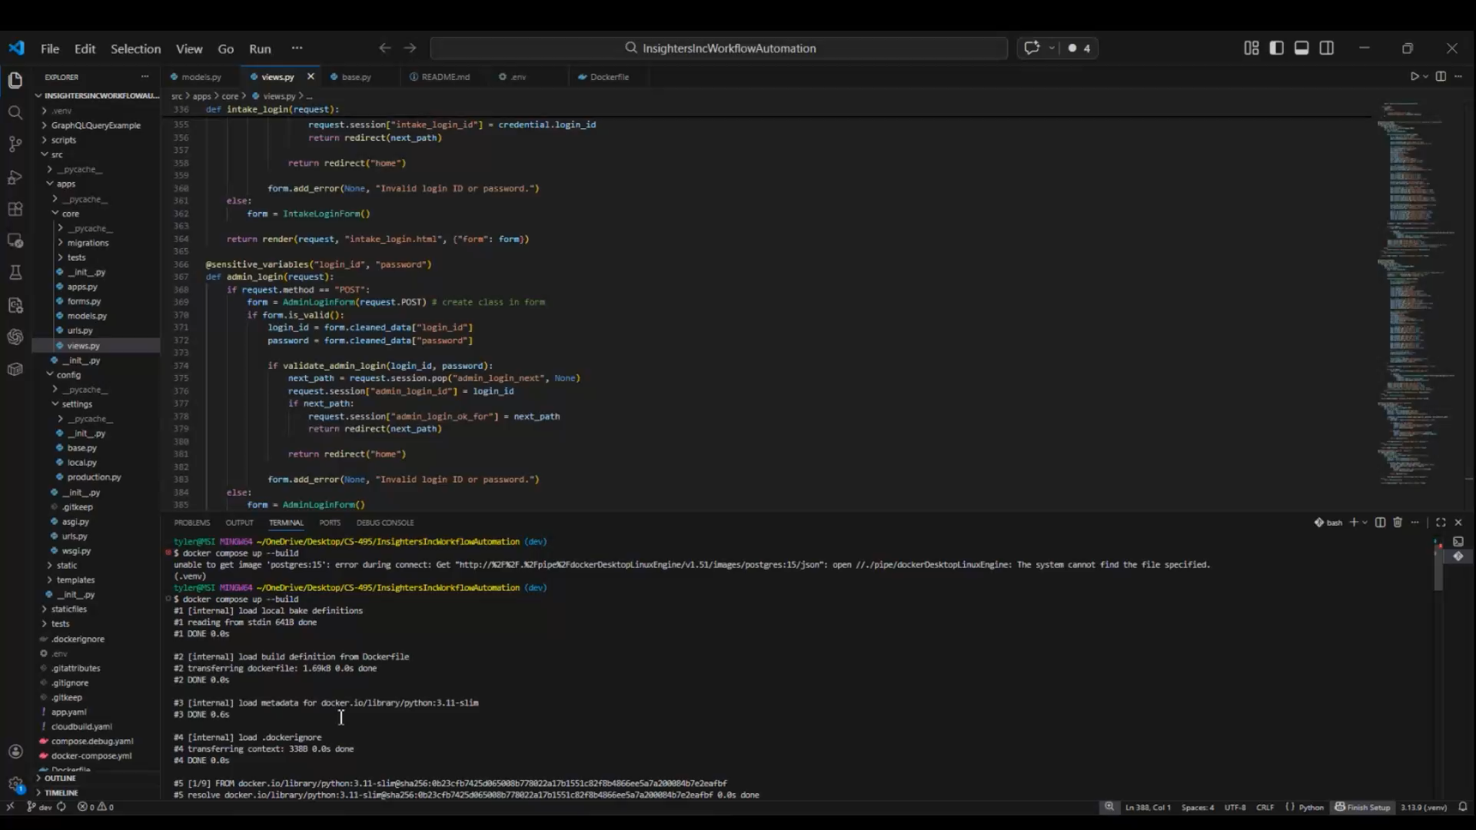
Functionality Demonstration – Video (For Website and Future Viewing)

